Slide 1


PLEDGE TO PROGRESS Sustainability Hackathon
Sponsored By
Your Team Name :
Your team bio :
Date :

Slide 2
Green Software Development
Green IT is an umbrella term referring to environmentally sound IT hardware, software, systems, applications, and practices. It encompasses three complementary approaches to improving environmental sustainability.
The way software is designed, developed, and deployed can have a major impact on energy consumption. Accordingly, companies should include software in their sustainability efforts. They should articulate a strategy that guides trade-offs and allows for flexibility, review and refine the software development life cycle, and use “sustainable” software to make cloud-based data centers greener.

Slide 3
Most common user adopter of Green Software Development
Different people try new products at varying speeds. For each product, we find consumption pioneers and early adopters. Other consumers adopt new products much later. Consumers pass through five stages in the process of adopting a new product.
Innovators
Early Adopters
Early Majority
Late Majority
Laggards

Slide 4
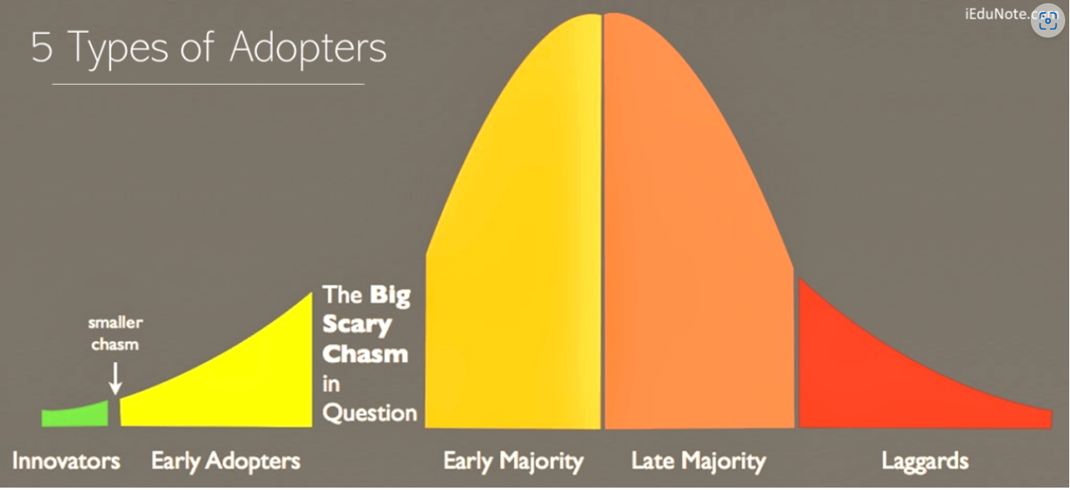
5 phase of Green Software Development
Different people try new products at varying speeds. For each product, we find consumption pioneers and early adopters. Other consumers adopt new products much later. Consumers pass through five stages in the process of adopting a new product.
Innovators
Early Adopters
Early Majority
Late Majority
Laggards

Slide 5
1. Innovators: The Risk Takers - The first users of the new product are called innovators.
Innovators are venturesome – They are willing to try new products at some risk.
2. Early Adopters: The Opinion Leaders - Early adopters are guided by respect. They are opinion leaders in their communities and adopt new products early but carefully.Early adopters make up 13.5% of the total purchasers. Although they do not move as quickly as innovators, they try a new product early in its life cycle without waiting for many people to accept it.
3. Early Majority: The Cautious Adopters - The early majority are deliberated. Although they are rarely leaders, they adopt a new product before the average person. They account for the next 34% to enter the market. They are distinctly different from the previous two groups of buyers – innovators and early adopters.
4. Late Majority: The Skeptics - The late majority are skeptical. They adopt an innovation only after a majority of people have tried it. This group comprises another 34% of the total market. This group sees even more risk in new products than do those in the early majority.
5. Laggards: The Last to Try New Products, Tradition-Bound Adopters - Laggards are tradition-bound. They are suspicious only when it has become something of a tradition itself. The last group of buyers makes up the last 16% make their purchases. They are the individuals, households, or organizations that resist or never adopt the new product. The most distinguishing characteristic of this group is their highly traditional buying patterns.

Slide 6
Alternatives or competitive of Green Software Development
Here we are mentioning Top 10 Alternatives & Competitors to Green Software Development
Capital Numbers
Trigma
G2 Deals
WeLoveNoCode
Vates
Net Solutions
Brancosoft
C2C
Glorium Technologies
MobiDev

Slide 7
Top 10 Tools for Microsoft Azure Development
Cloud computing is slowly turning out to be a staple for every business. Cloud computing provides essential safeguards against unnecessary expenditures and overheads. Most important of all, businesses could shift the tasks of maintaining servers and databases to fully managed services with cloud computing. The search for Azure development tools and other cloud computing resources is common for every business. The basics of Microsoft Azure cloud development could be the starting to master the concepts of Azure development gradually. You can learn to create and customize dashboards in the Azure portal alongside sharing them with team members. The starting guide for azure cloud development could also help in the creation and deployment of simple .NET Core web app and database by leveraging the Azure portal. 1. Azure Ping 2. Cloud Explorer for Visual Studio 3. Cloud Combine 4.. SQL Database Migration Wizard 5. Azure Blob Studio 6. Microsoft Azure Storage Connected Service 7. Graph Engine VS Extension 8. Docker 9. Azure developer portal 10. Azure Grid

Slide 8
Methodology, solution architecture & scalability
Present your solution, talk about methodology, architecture & scalability
methodology - Software development teams are known for using a wide variety of agile methodologies, approaches, and tools to bring value to customers. Depending on the needs of the team and the product's stakeholders, it’s common for teams to deploy and utilize a combination of software development methodologies.
Solution architecture is the process of designing and communicating the high-level structure and behavior of a system that solves a specific problem or meets a specific goal. As a solution architect, you need to tailor your communication to different audiences, depending on their roles, interests, and perspectives. How do you choose the right solution architecture view for your audience? In this article, we will explore some tips and best practices to help you select and present the most relevant and effective views for your stakeholders.
Scalability is the property of a system to handle a growing amount of work by adding resources to the system.
In other words, a scalable architecture supports higher workloads without any fundamental changes to it. Notice the part about adding resources: Scalability doesn’t mean that an application magically handles extra traffic with the same resources.

Slide 9
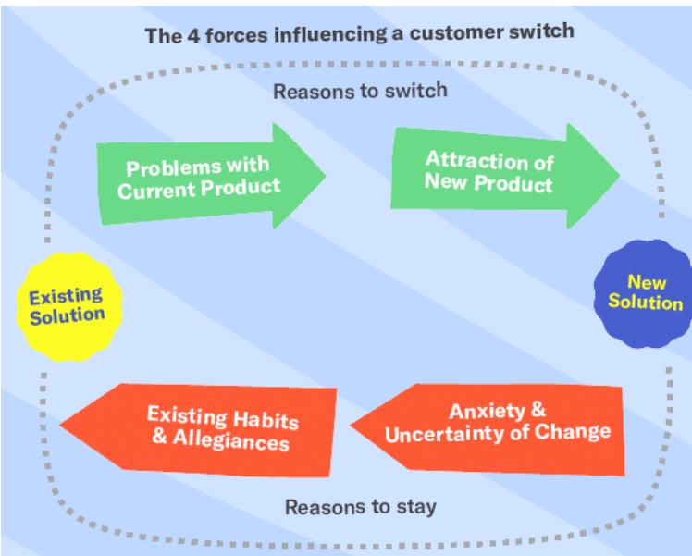
Differentiators in software development
Product adoption describes the process of users becoming aware of a product, understanding its value, and beginning to use it. The process is usually broken down into four discrete stages: awareness, interest, evaluation and conversion.
4 forces that influence product adoption

Slide 10
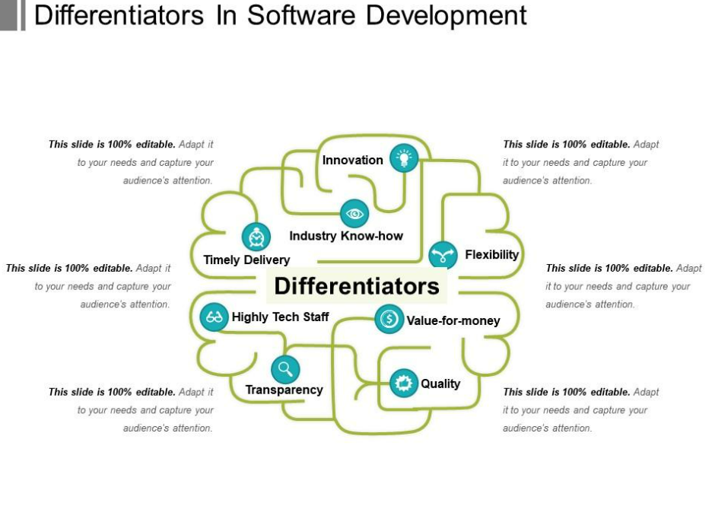
Differentiators in software development
Increase the push-away – Point out flaws in the prospect’s current product.
Increase your product magnetism – Show how well your product solves the prospect’s problems.
Decrease the fear and uncertainty of change – Explain how easy it is to switch to your product.
Decrease their attachment to the status quo – Remove prospects’ fondness for their current product.

Slide 11
GitHub Repository Link & supporting diagrams, screenshots, if any
Without doubt, software is the backbone of virtually all the intelligent solutions designed to support the environment. It’s critical, for example, in efforts to tackle deforestation and reduce emissions. In many instances, however, software is also part and parcel of a rapidly growing carbon footprint. In fact, recent and proliferating digital technologies have begun to worsen many of the environmental problems they are aimed at solving. But companies can make software an integral part of their sustainability efforts by taking its carbon footprint into account in the way it is designed, developed, and deployed and by rethinking some aspects of how the data centers that provide cloud-based services operate.
Let’s be clear: On its own, software doesn’t consume energy or emit any harmful discharge. The problem lies in the way software is developed for use — and then in the way it is used. Software runs on hardware, and as the former continues to grow, so does reliance on the machines to make it run.
Then there’s the information and communications technology sector as whole. By 2040, it is expected to account for 14% of the world’s carbon footprint — up from about 1.5% in 2007.
The very development of software can be energy intensive. For example, consider what we learned when we trained an artificial intelligence (AI) model on a small, publicly available dataset of iris flowers. The AI model achieved accuracy of 96.17% in classifying the flowers’ different species with only 964 joules of energy. The next 1.74%-point increase in accuracy required 2,815 joules of energy consumption. The last 0.08% incremental increase in accuracy took nearly 400% more energy than the first stage.

Slide 12
Thank You
Team member names

